Slide 1
CSS – Background Images

Slide 2

Border-image property
The border-image CSS property allows drawing an image on the borders of elements.
The property has three parts:
The image to use as the border
Where to slice the image
Define whether the middle sections should be repeated or stretched
We will use the following image (called "border.png"):

Slide 3
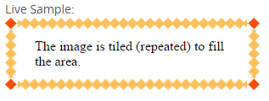
Repeat property
The image is sliced and simply tiled to fill the border area.
<div id="round">The image is tiled (repeated) to fill the area.
</div>
#repeat
{
border: 15px solid;
border-image:
url("/files/4127/border.png") 30 30 repeat;
}

Slide 4
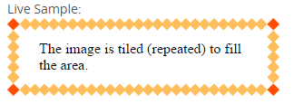
Round property
The round option is a variation on the repeat option that distributes the tiles in such a way that the ends nicely connect.
#round
{
border: 15px solid;
border-image:url("/files/4127/border.png") 30 30 round;
}

Slide 5
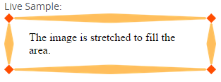
Stretch property
The 'stretch' option stretches the images to fill the border area.
#stretch
{
border: 15px solid;
border-image:
url("/files/4127/border.png") 30 30 stretch;
}

